Slide 1
7FNCE040W
Business Analytics
WEEK 6 Bite 3

Slide 2
Lets practice with an example In-class Exercise
How do consumers view supermarket shopping?
Data set: ‘supermarket shopping.sav’
Notes:
A supermarket chain asked 500 of its customers to fill in a questionnaire which contained the 12 questions ( items0, which are measured on a 7-point likert scale, from 1 = strongly disagree to 7 = strongly agree.
Yopur task is to identify the major factors that influence consumers’ view of shopping and report your findings to the supermarket management.
The data file is on Blackboard, named supermarket shopping.sav.

Slide 3
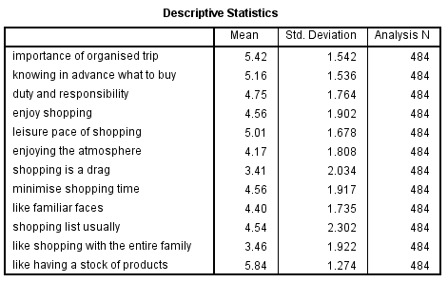
Enough observations?
Notes:
Do you have enough data?
Yes, more than 50 observations
Yes, more than 60 (12*5) observations

Slide 4
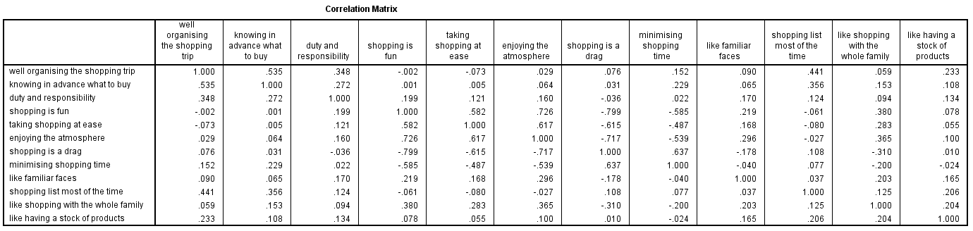
Any High Correlations?
Notes:
Are any of the variables correlated?
Just based on the first few columns, we see an indication that factor analysis may be useful
Well organised shopping appears correlated with knowing what to buy in advance, duty & responsibility, and taking a
list most of the time.
Shopping is fun appears correlated with taking shopping at ease and enjoying the atmosphere and negatively correlated with shopping is a drag and minimising the time spent shopping.

Slide 5
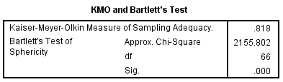
Is Factor Analysis Appropriate?
Notes:
Statistic?
KMO>.5
Bartlett’s Chi-square has significant <0.05 which indicated reject H0; factor Analysis is NOT APPROPRIATE

Slide 6
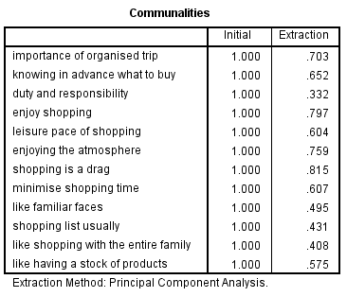
How much variance explained?
Notes:
Based on ‘The solution’ created by SPSS, we can see from this table how much variance in each variable is preserved.

Slide 7
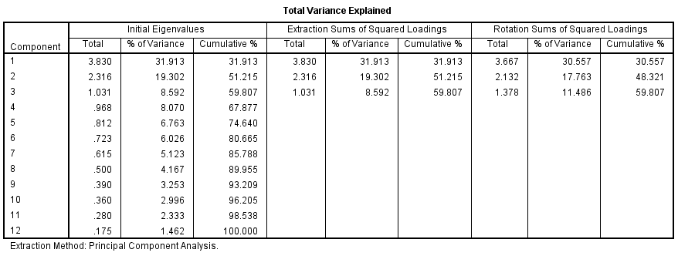
Number of Factors?
Notes:
How many factors?
It seems that either 3 or 4 may work
The SPSS solution is 3 factors
In total 59.907% of the variance is explained – this is close to 60% minimum
The eigenvalue for the 4th factor is quite close to 1, so 4 factors may be appropriate
With the 4th factor the % of variance explained would increase to 67.877 – this is good.

Slide 8
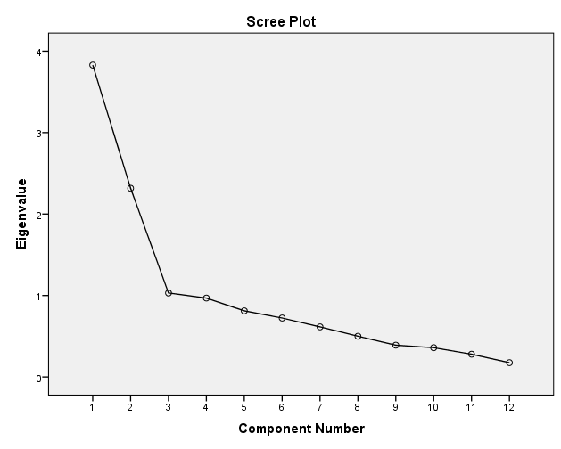
Number of Factors?
Notes:
The scree plot seems to indicate, again, that 3 or 4 would work.
The line levels out at 3
4th factor is also quite close to the line at eigenvalue = 1
May need to hold off on this decision to see about interpretation

Slide 9
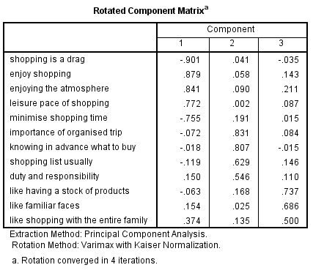
Do the groupings make sense?
The Experience
The Preparation
Notes:
Factor 1 makes sense – labelled ‘The Experience’
Factor 2 makes sense – labelled ‘The Preparation’
Factor 3
Not sure why these two f=variables would go together
Seems to be due to mathematics
Last variable doesn’t fall into just one factor – in both 1 and 3
I decided to remove all 3

Slide 10
Construct & Discriminant Validity
The Experience
The Preparation
Notes:
Check convergent validity – Remember convergent validity thresholds depends on sample size
Sample size: 60 Sufficient loading: 0.70
Sample size: 70 Sufficient loading: 0.65
Sample size: 85 Sufficient loading: 0.60
Sample size: 100 Sufficient loading: 0.55
Sample size: 120 Sufficient loading: 0.50
Sample size: 150 Sufficient loading: 0.45
Sample size: 200 Sufficient loading: 0.40
Sample size: 250 Sufficient loading: 0.35
Sample size: 350 Sufficient loading: 0.30
Factor 1 Ok all greater than .30
Factor 2 Ok all greater than .30
Factor 3 Ok all greater than .30
2. Check discriminant validity
Factor 1 Ok all greater than> .20
Factor 2 Ok all greater than > .20
Factor 3 problem with last item – doesn’t fall into just one factor
3. I decided to remove all 3 items in factor 3 & rerun the analysis

Slide 11
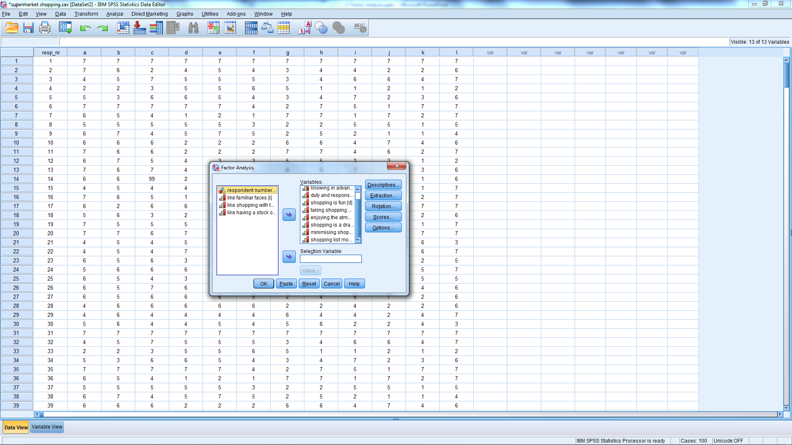
Revised Factor Analysis
Notes:
Remove the 3 questionable variables out of the variable box.

Slide 12
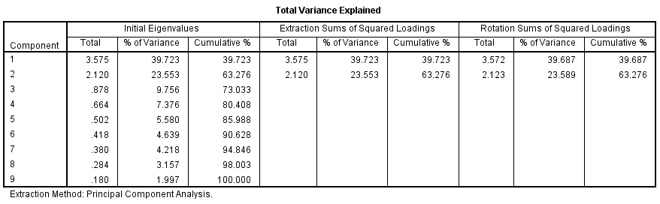
2 Factor Solution
Notes:
In SPSS Solution, the Total variance explained > 60%
This indicates that 2 factors is acceptable

Slide 13
New Scree Plot?
Notes:
3 component solution is where line levels off
But, below 1.
Indicate that 2 might work

Slide 14
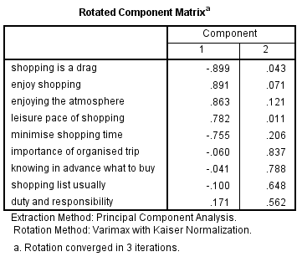
Construct Validity
Construct
Discriminant
All load onto one factor
All loadings differ by >.20
Notes:
Construct validity:
N = 500 therefore the significant loadings should be at least .3
All are greater
Discriminant validity
Both factor OK
All items fall into just one factor

Slide 15

2 Factor Solution
Reliability?
Note need to recode
Notes:
Before doing the reliability analysis, is there a need to recode any data?
Yes, recode the following variables before obtaining the Cronbach alpha for Factor 1:
Shopping is a drag
Minimise shopping time

Slide 16


Reliability
Experience
Preparation
Notes:
Are these scales reliable ( >.60 for new scales and >.70 for established items)?
These reliability statistics show that the items are good at representing factors.
Insert reliability statistics here

Slide 17
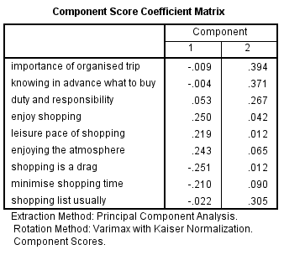
2 Factor Solution

Slide 18
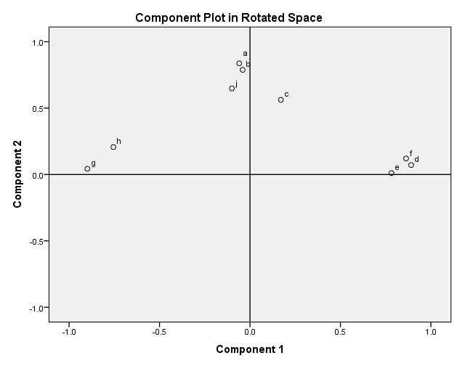
2 Factor Solution
Notes:
From this chart you can see the variables that form Component 1 because they fall along the horizontal axis and those that form Component 2 because they fall along the vertical axis.

Slide 19
Assessment for Management
Seems to be 2 factors in shopping
The experience
Prolong the time shopping
Enjoying the activity of shopping
Enjoying the Atmosphere
The Preparation
Being organised
Making a list and knowing what to buy
Committed to duty & responsibility
Notes:
Are these factors in management control?
Could management do anything about the experience?
These factors may actually segment consumers – this topic will be covered next week in Cluster Analysis

Slide 20
What’s Next?
Topic
Read
Chapter 5 & 6
Cluster Analysis
Segmentation

